Slide 1
Discrimination
Definition of discrimination: members of a group (women, blacks, Muslims, immigrants, etc.) are treated differentially (less favorably) than members of another group with otherwise identical characteristics in similar circumstances.
Focus: labor market discrimination, i.e. firms choosing to pay some workers less than other workers

Slide 2
Types of discrimination
Taste-based: some employers have a distaste for hiring members of the minority group, and, as a result, may refuse to hire members of this group, or may pay them less than other employees with same productivity.
If the fraction of these employers is large enough, there will be an economy-wide wage differential between majority and minority groups.

Slide 3
Types of discrimination
Taste-based: some employers have a distaste for hiring members of the minority group, and, as a result, may refuse to hire members of this group, or may pay them less than other employees with same productivity.
If the fraction of these employers is large enough, there will be an economy-wide wage differential between majority and minority groups.
However, non-discriminatory firms will earn higher profits than discriminatory firms, and so over time the market should push out discriminatory firms.

Slide 4
Types of discrimination
Statistical discrimination: Employers have imperfect information about quality of workers applying, observing only noisy signals of productivity.
One such signal could be majority/minority status. If members of majority group are, on average, more productive than members of a minority group, employers may decline to hire minority applicants.

Slide 5
How common is discrimination?
Both types of discrimination are illegal in US labor and housing markets.
However, enforcement is challenging; employment decisions are often made on the basis of data points which are not easily observed.
While taste-based discrimination may be transient, statistical discrimination could be self-reinforcing. If a minority group perceives few labor market opportunities, the incentive to invest in education, training, etc. is diminished.

Slide 6
Measuring discrimination
In 2014, women who worked full-time earned a median weekly wage of $719, or 83% of men’s weekly wage of $871.
However, the male-female wage differential varies by field.

Slide 7
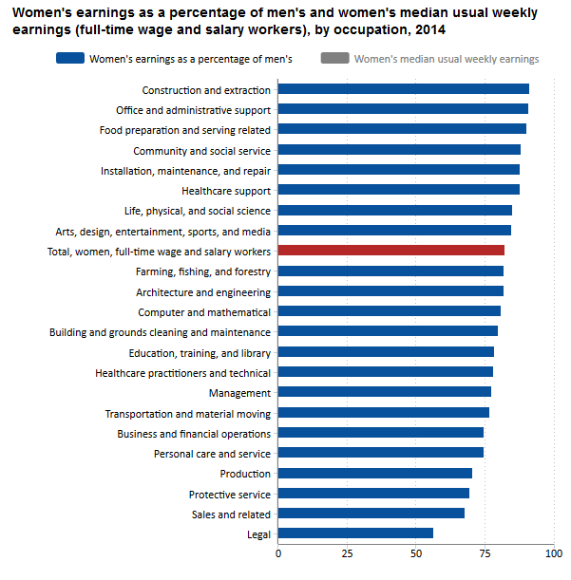
Measuring discrimination

Slide 8
Measuring discrimination
Multiple regression studies find only a portion of the male-female wage gap (perhaps 5%) remains after controlling for observable worker and job characteristics.
Men and women make different choices about which field and job to pursue.
To the extent these choices reflect different preferences, a wage gap resulting from different choices isn’t due to discrimination.
However, to the extent these choices are informed by perceived opportunities across field and job, different choices could themselves be caused by discrimination.

Slide 9
Audit studies
Two actors are matched as closely as possible, except for one dimension (usually race or gender). They both apply for the same job.
Example: Neumark, Bank, and Van Nort (1996). Male-female pairs applied to 65 Philadelphia restaurants. 10/13 job offers at high-end restaurants made to males. 8/10 job offers at low-end restaurants made to women.
Another: When applying to the same job, 5% of blacks with a “criminal record” were called back, versus 14% who didn’t have one. For whites, 17% and 34%.

Slide 10
Field studies
Bertrand and Mullainathan (2004) sends fake resumes responding to Chicago and Boston help-wanted ads. Assign white-sounding names (e.g. Emily Walsh) to half, black-sounding names (e.g. Lakisha Washington) to other half. Resumes are otherwise identical. White names receive 50% more interview requests.
When varying quality, whites with high-quality resumes receive 30% more interview requests than whites with low-quality resumes. For blacks, 9% (and statistically insignificant from 0).

